Slide 1
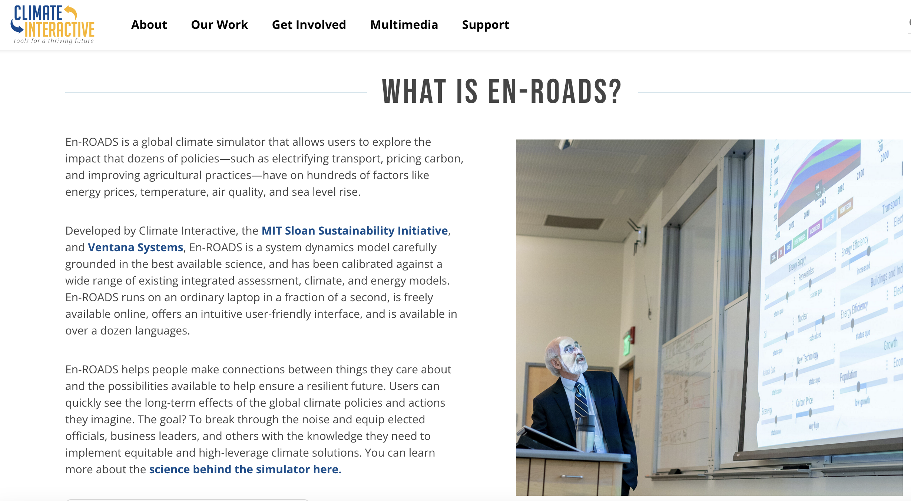
EnROADS

Slide 2
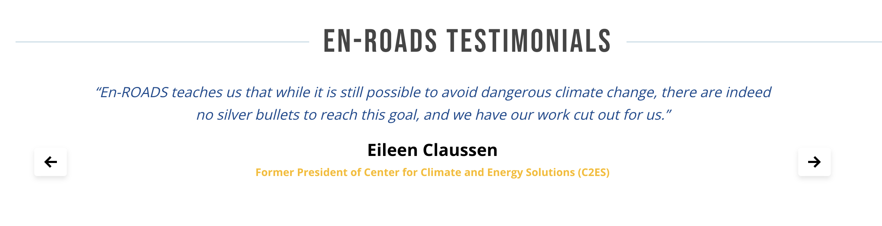
EnROADS

Slide 3
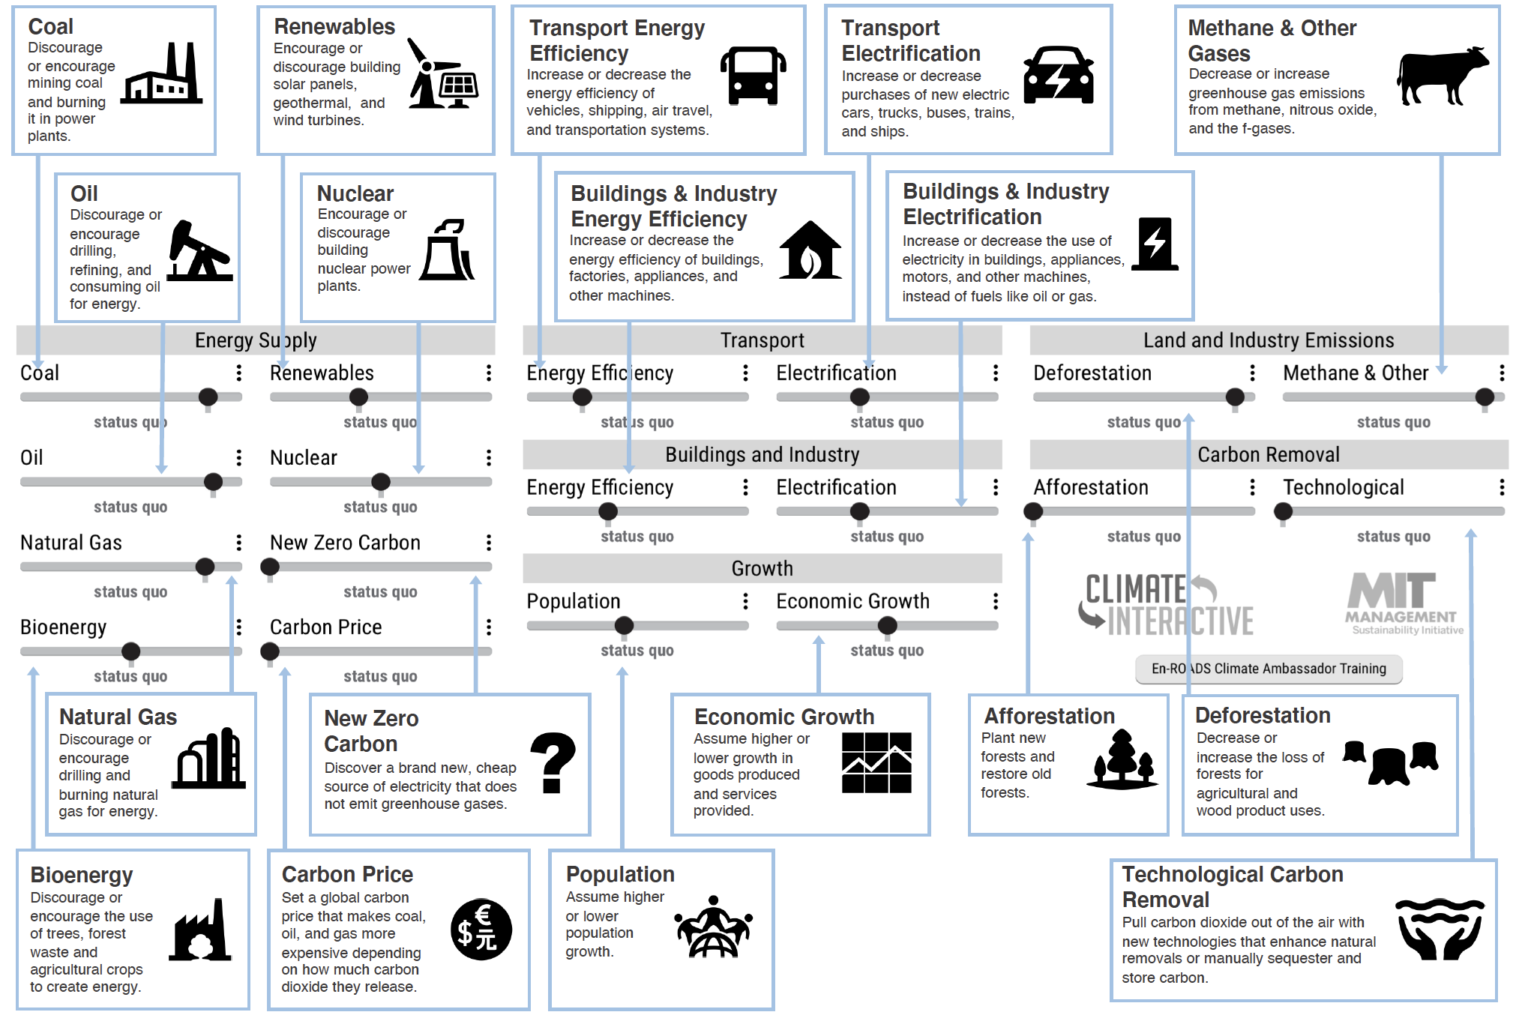
Notes:
Note – Use the En-ROADS control panel guide to help orient participants to their decision variables e.g., 18 levers. Use this time to also briefly orient people to the actual En-ROADS simulator, and show how this Guide relates to the En-ROADS simulator.

Slide 4
Mission 1:
We’d like to be able to evaluate the scientific basis, thent a given model has built in. Our method will be to evaluate the “Equilibrium Climate Sensitivity” built into the model
ECS = (△T_{OBS}/△C_{CO2}) x 290

Slide 5
Mission 1:
Create a scenario that (barely) limits warming to 2°C and calculate equilibrium climate sensitivity (ECS)
ECS = (△T_{OBS}/△C_{CO2}) x 290

Slide 6
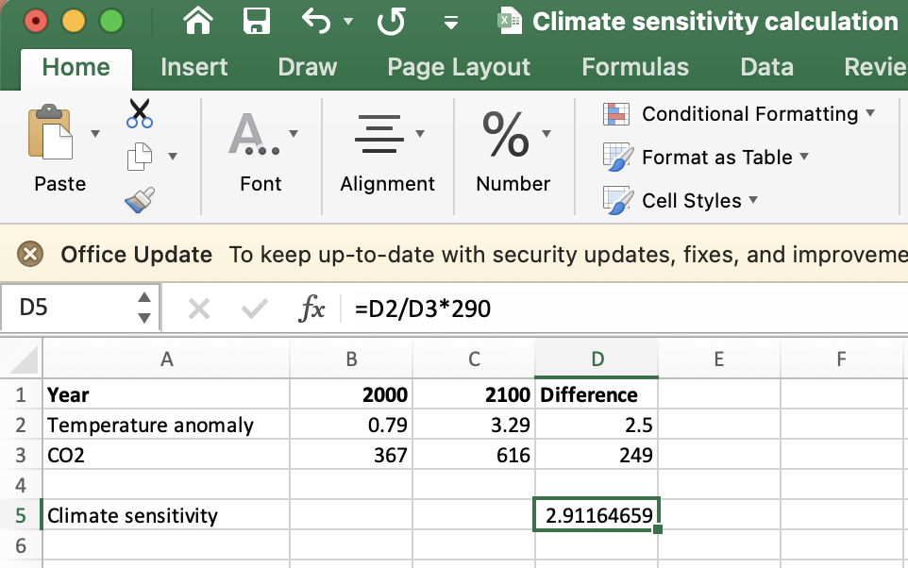

Mission 1:
ECS = (△T_{OBS}/△C_{CO2}) x 290

Slide 7
Mission 1:
ECS = (△T_{OBS}/△C_{CO2}) x 290

Slide 8
Co-Benefits
Positive “side effects” of actions to reduce greenhouse gas emissions.
*Effects often felt sooner than slow climate effects.

Slide 9
Co-Benefits
Multi-Solving
Positive “side effects” of actions to reduce greenhouse gas emissions.
*Effects often felt sooner than slow climate effects.
Climate change solutions rooted in justice that produce co-benefits in health, resilience, and well-being while also protecting the climate.

Slide 10
One Action - Multiple Outcomes
Reduce Greenhouse Gas Emissions
Burn Less Coal
Long Term Benefit for the Global Climate

Slide 11
One Action - Multiple Outcomes
Reduce Greenhouse Gas Emissions
Burn Less Coal
Improve Air Quality
Improve human health in places where there is pollution from coal powered energy
Long Term Benefit for the Global Climate

Slide 12
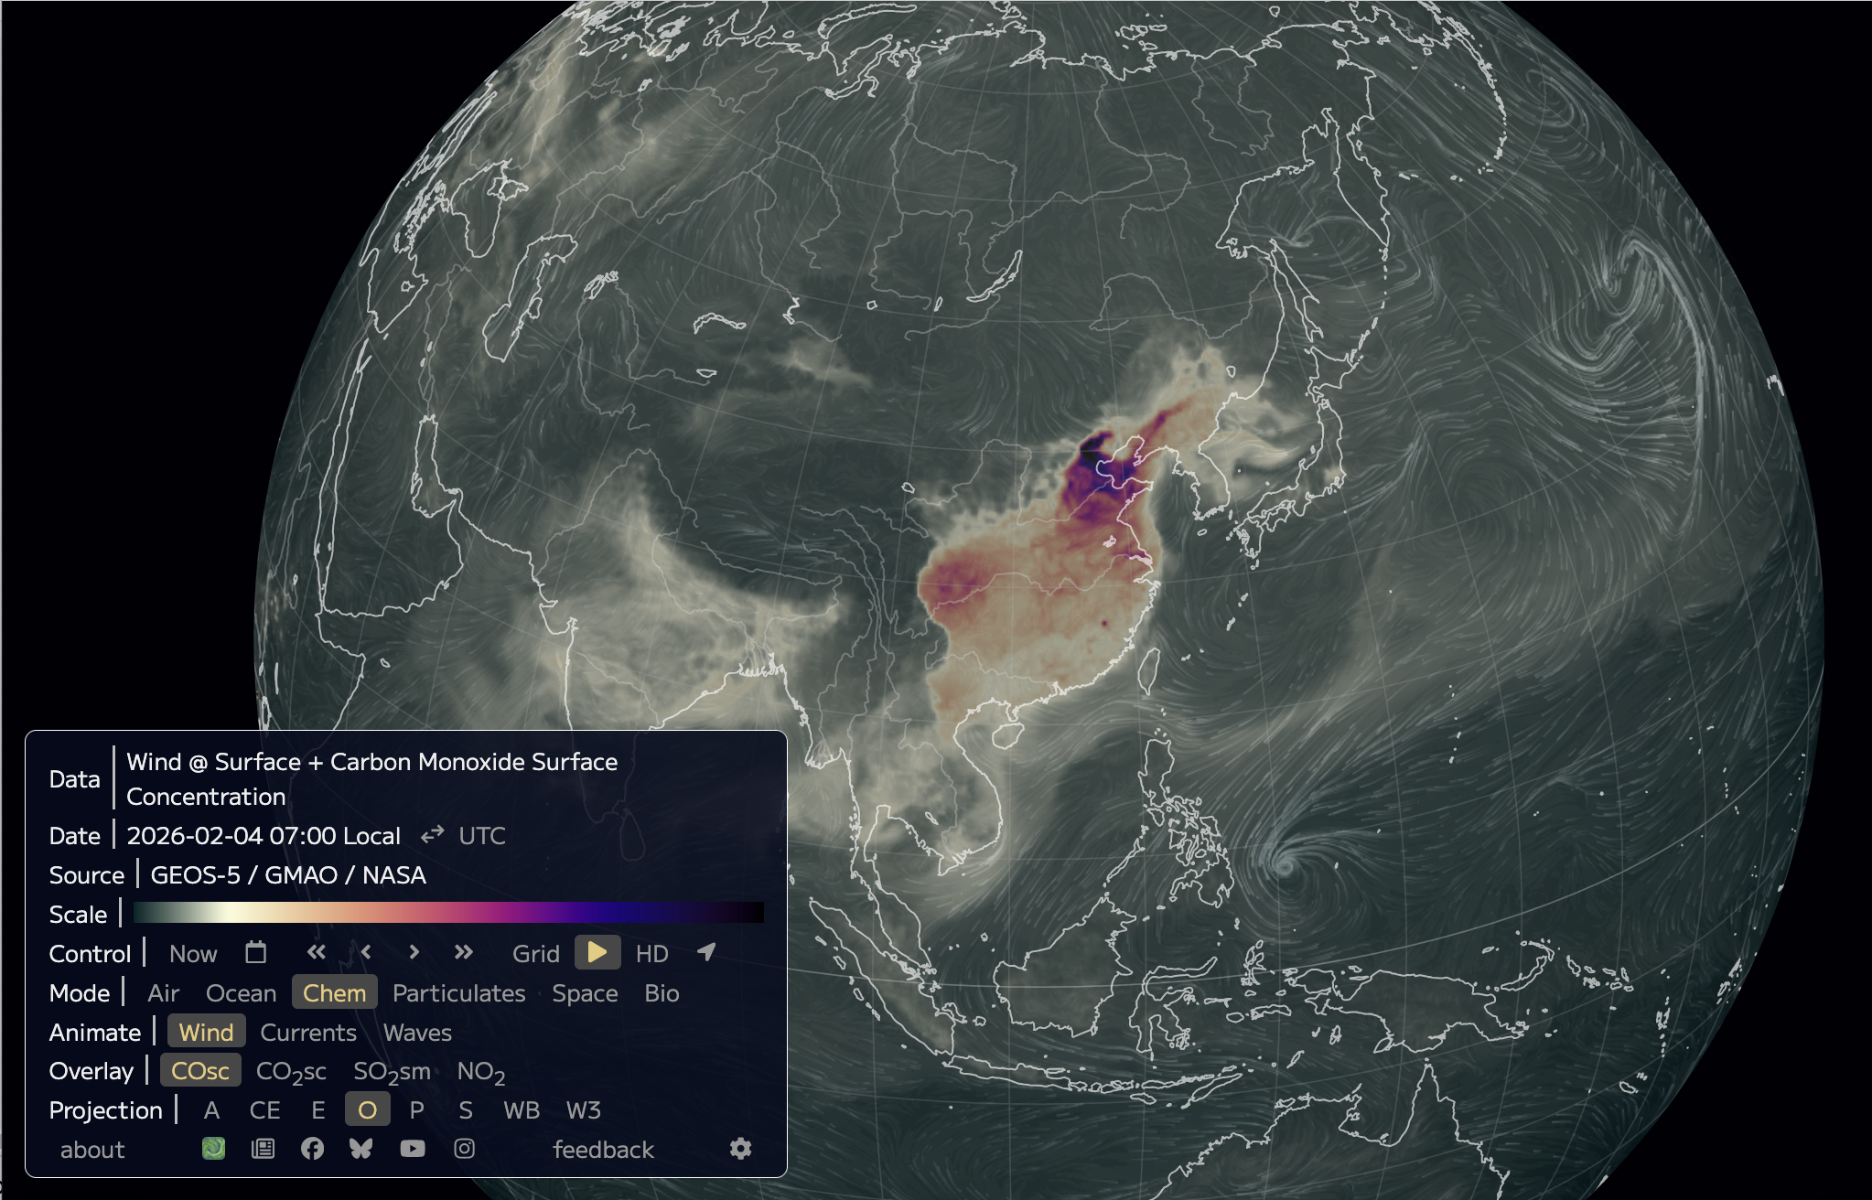
We’ve seen the pollution problem in Earth.nullschool.net

Slide 13
Mission 2:
Adjust your sliders to maximize co-benefits, multi-solving, and feasibility. Once you are done, pitch your imagined reality to a classmate near you!

Slide 14
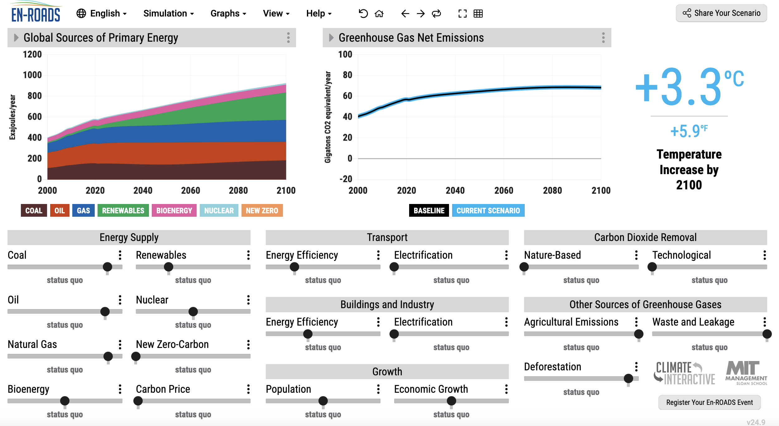
OK, let’s get started
Mission 1: Create a scenario that (barely) limits warming to 2°C and calculate equilibrium climate sensitivity (ECS)
ECS = (△T_{OBS}/△C_{CO2}) x 290
What does this tell us about the model?
Pessimistic if ECS > 3°C/2xCO₂
Optimistic if ECS < 3°C/2xCO₂
Mission 2: Adjust your sliders to maximize co-benefits, multi-solving, and feasibility. Once you are done, pitch your imaged reality to a classmate near you!

